Slide 1

The State of Our Parks:
Current Budget Reality

Slide 2
Historical Funding Perspective
1950’s – 1970’s Growth of Lane County Parks
  Period of park acquisition & development
  Timber Revenue, General Fund, Gas Tax, Grants, Small amount of User Fees
  Middle of 1970’s over 35 FTE
1980’s Decline of Lane County Parks
  More facilities than could adequately maintain
  No stable source for maintenance and operation
  1982 Economic recession led to closing of parks

Slide 3
Historical Funding Perspective
1983-2000 Rebirth of Lane County Parks
  5 - 10% Car Rental Tax for operations & maintenance (45% of operation budget by 2000)
  1985 County Hired full-time Parks Manager to rebuild park system
  Eliminated reliance on General Fund & increased User Fees
  Adopt-A-Park Program (1997 - 15,000 Volunteer Labor Hrs.)
  1995 4-Year Capital Improvement Plan (CIP)
  FY 99: 59 Parks with Operating Budget over $1.5M & Capital Improvement Budget was over $1M, 17FTE

Slide 4
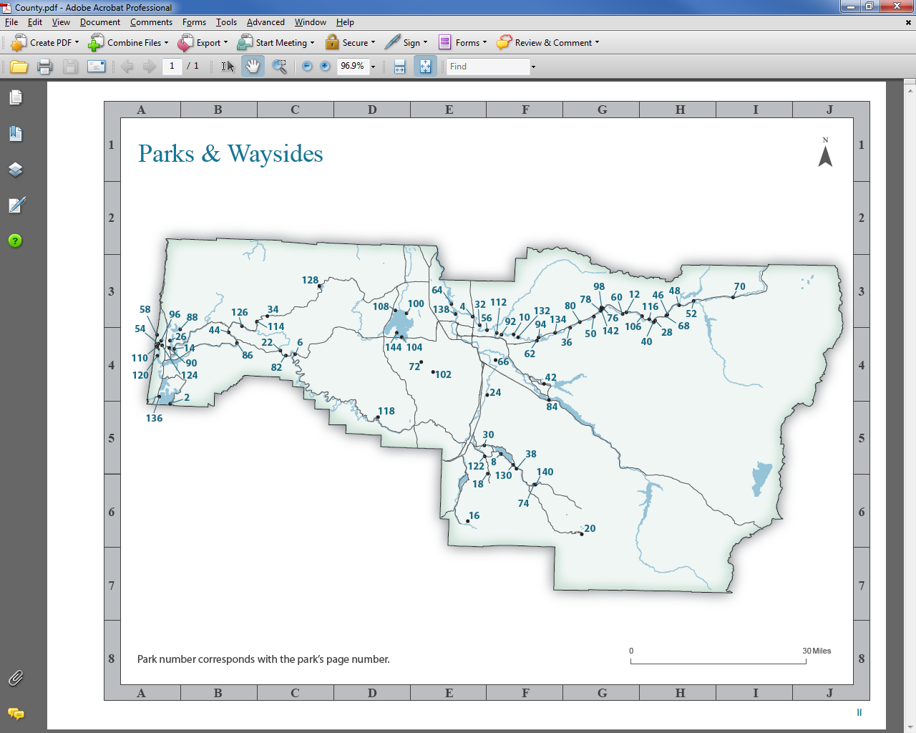
2020 Lane County Parks System
69 Properties encompassing 4,550 acres
5 Campgrounds (227 RV campsites) & 3 Marinas (400 slips), 43 Boat Ramps
Admissions 2014-2019 (day-use: 67,500 – 83,000, season passes: 5,088 – 7,475) & Camping Reservations (15,800 – 30,000)

Slide 5
FY 20 REVENUE SOURCES
FY 20 ANNUAL REVENUE = $4,872,643

Slide 6
FY 20 OPERATING & CAPITAL BUDGET
Operating Budget - $3,988,282
  Personnel 18.8 FTE - $1,850,522
  Materials & Services - $2,188,736
Capital Budget - $549,227
System Development Charges - $228,884

Slide 7
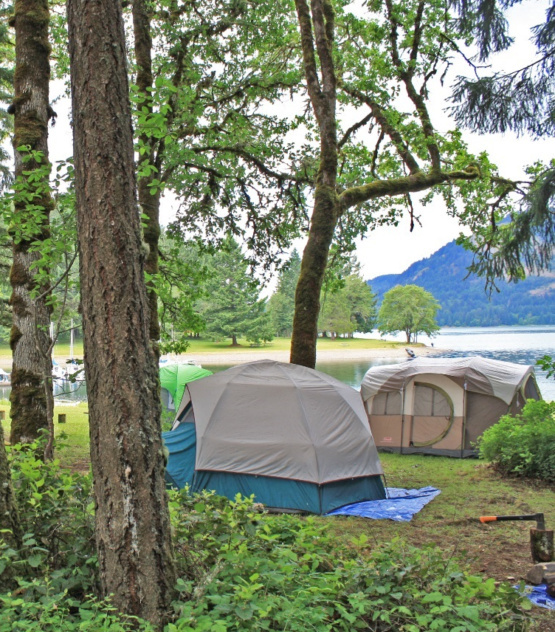
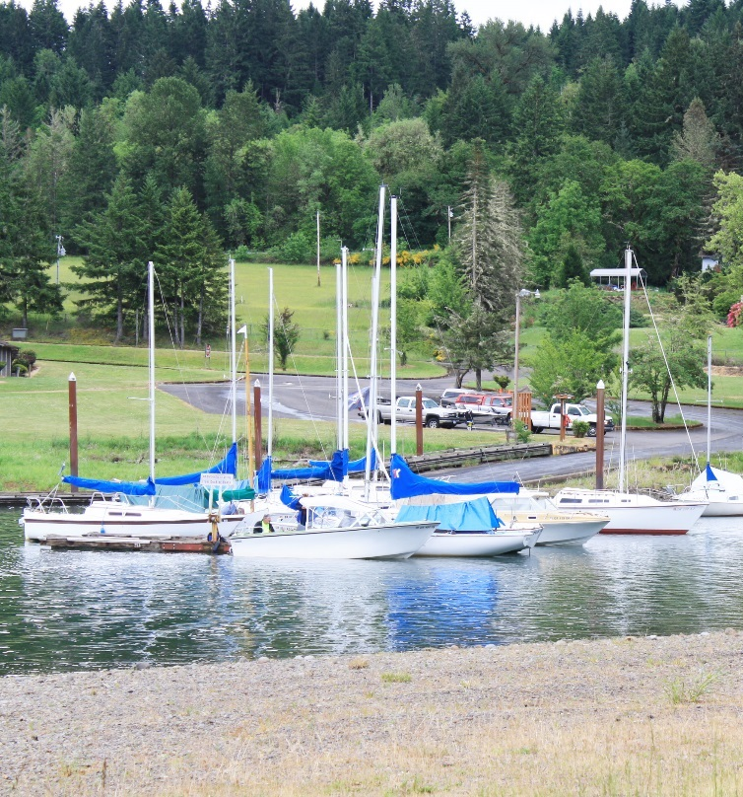
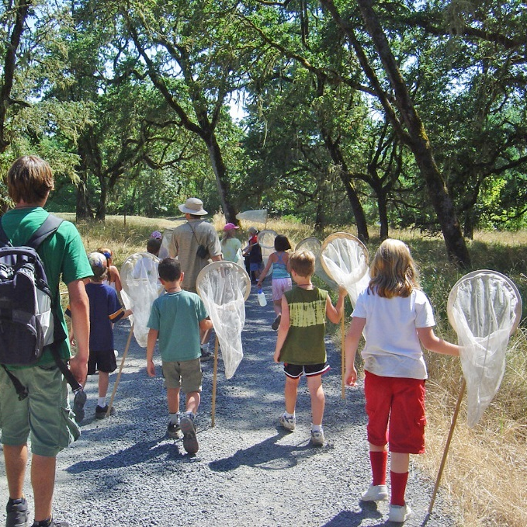


LANE COUNTY PARKS & OPEN SPACE MASTER PLAN
SEA TO SUMMIT: Creating the Future of Lane County Parks
Board of Commissioner Hearing
December 18, 2018

Slide 8
Vision
2018 LANE COUNTY PARKS & OPEN SPACES MASTER PLAN
GOAL 4: Generate Economic Vitality
Create a strategic and holistic park management approach
that balances local/site needs with opportunities to create economic benefits or to generate revenue to re-invest in parks.
Strategy 4.5: Develop additional resources and funding for Lane County Parks

Slide 9
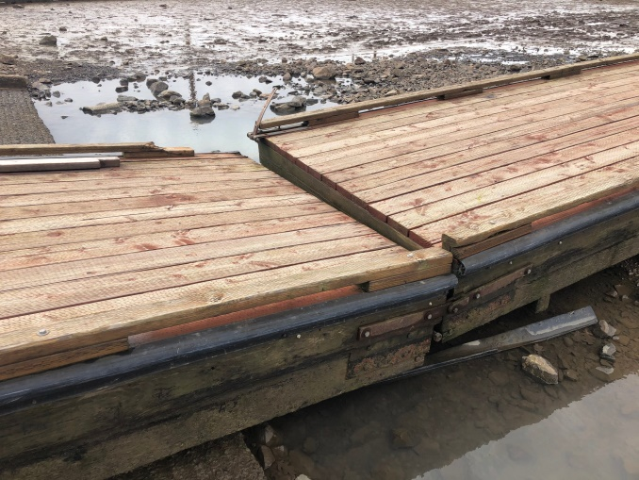
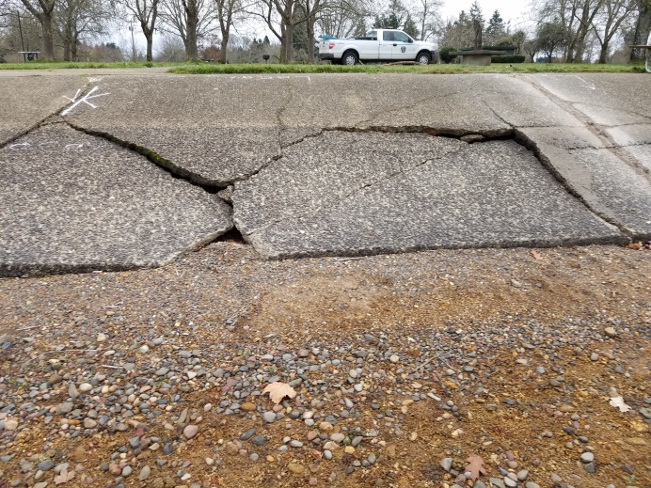
Mission
DEFERRED MAINTENACE
Over $17M Backlog of deferred maintenance
  Aging infrastructure of parks system
2 Ways to tackle deferred maintenance:
1. Restoration of facilities (capital projects)
2. Routine preventative maintenance

Slide 10
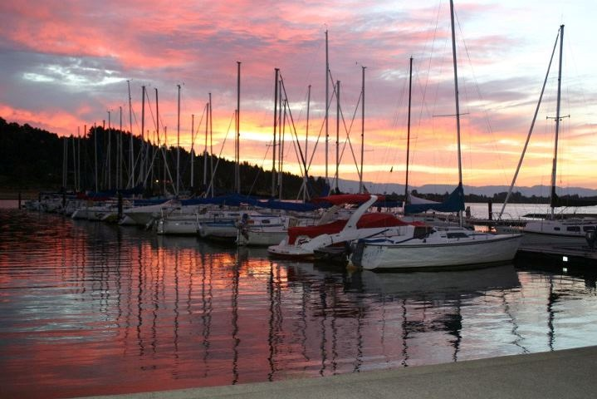
FUNDING PRIORITIES
What is the optimal operating budget?
What is the optimal capital budget?
What are the funding priorities?
  Def. Maintenance
  Capital Improvements
  Conservation
  Revenue Generation

